Slide 1
LAB 2 INTRODUCTION TO VHDL
FACULTY OF ENGINEERING
CAIRO UNIVERSITY
CMPN301: COMPUTER ARCHITECTURE COURSE
EXERTED FROM DR. ADNAN SHAOUT- THE UNIVERSITY OF MICHIGAN-DEARBORN

Slide 2
What we learned last time
How to create Entity
How to implement Architecture
What different modeling could be used (Dataflow , behavioral, structural)
Code is Concurrent not sequential
“WHEN … ELSE” statement is concurrent only
Signals are wires
Different data types
How to reuse previously created entity (component instantiation a.k.a port mapping)
Intro to VHDL
Architecture course
‹#›

Slide 3
Objectives
Review Conditional Concurrent statements
Others Keyword
Learn about Generic entities
Learn about For-Generate and if-Generate
Intro to VHDL
Architecture course
‹#›

Slide 4
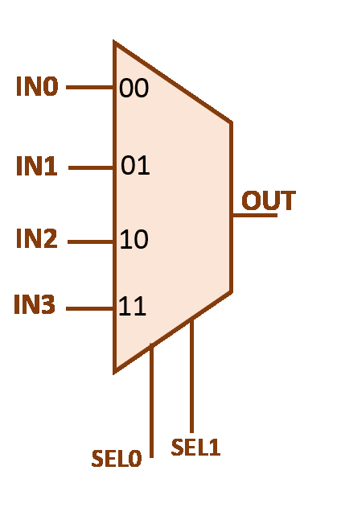
Remember Mux4x1
ENTITY mux IS
PORT( in0,in1,in2,in3: IN std_logic;
sel : IN std_logic_vector (1 DOWNTO 0);
out1: OUT std_logic);
END mux4;
Intro to VHDL
‹#›
Architecture course

Slide 5
When … ELSE / With … Sel
ARCHITECTURE a_mux OF mux
BEGIN
out1 <= in0 WHEN sel = “00”
ELSE in1 WHEN sel = “01”
ELSE in2 WHEN sel =“10” ELSE in3;
END a_mux;
ARCHITECTURE b_mux OF mux
BEGIN
with sel select
out1 <=
in0 when "00",
in1 when "01",
in2 when "10",
in3 when "11";
END b_mux;
Intro to VHDL
Architecture course
‹#›

Slide 6
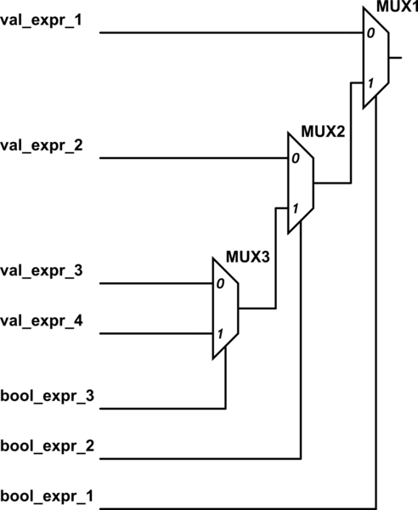
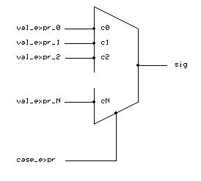
When … ELSE / With … Sel
Intro to VHDL
Architecture course
‹#›

Slide 7
When … ELSE / With … Sel
What happens if we missed a case ?!
F <= a when Sel = “00”;
-- what is the Value of F if Sel is not 00 ?!!!!
Intro to VHDL
Architecture course
‹#›

Slide 8
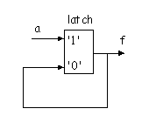
When … ELSE / With … Sel
What happens if we missed a case ?!
A latch will be formed to save previous value
F <= a when Sel = “00”;
-- what is the Value of F if Sel is not 00 ?!!!!
Intro to VHDL
Architecture course
‹#›

Slide 9
Objectives
Review Conditional Concurrent statements
Others Keyword
Learn about Generic entities
Learn about For-Generate and if-Generate
Intro to VHDL
Architecture course
‹#›

Slide 10
“OTHERS” Keyword
Use “OTHERS” Whenever you want to:
Set a bus to several zeros or several 1s but you don’t want to write it.
Example set F to 32 zero
F <= “00000000000000000000000000000000”;
F <= x“00000000”; -- hexdecimal
F<= (Others => ‘0’);
Intro to VHDL
Architecture course
‹#›

Slide 11
“OTHERS” Keyword
Use “OTHERS” Whenever you want to:
Set a bus to several zeros or several 1s but you don’t want to write it.
Set a certain bit to value and others zero
Example set F to 128 zero
F <= “00000000000000000000000010000000”;
F <= x“00000080”; -- hexdecimal
F<= (4=>‘1’, Others => ‘0’);
Intro to VHDL
Architecture course
‹#›

Slide 12
“OTHERS” Keyword
Use “OTHERS” Whenever you want to:
Set a bus to several zeros or several 1s but you don’t want to write it.
Set a certain bit to value and others zero
Generic Case in Switch Cases
Example set F to 128 zero
With S select
F <= a when “0010”,
b when others;
Intro to VHDL
Architecture course
‹#›

Slide 13
Objectives
Review Conditional Concurrent statements
Others Keyword
Learn about Generic entities
Learn about For-Generate and if-Generate
Intro to VHDL
Architecture course
‹#›

Slide 14
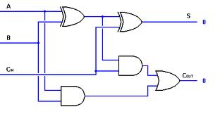
Let’s build a full adder ☺
Intro to VHDL
Architecture course
‹#›

Slide 15
1bit-adder example
ENTITY my_adder IS -- single bit adder PORT( a,b,cin : IN std_logic; s,cout : OUT std_logic); END my_adder;
ARCHITECTURE a_my_adder OF my_adder IS
BEGIN s <= a XOR b XOR cin; cout <= (a AND b) or (cin AND (a XOR b));
END a_my_adder;
Intro to VHDL
Architecture course
‹#›

Slide 16
Now how to build 4-bits full adder from 1-bit full adder?
Intro to VHDL
Architecture course
‹#›

Slide 17
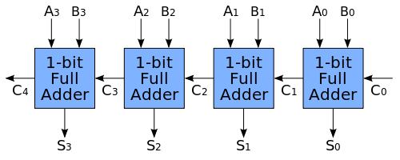
Carry-Propagate Adder
Intro to VHDL
Architecture course
‹#›

Slide 18
4 Bit-full Adder
ENTITY my_nadder IS
PORT (a, b : IN std_logic_vector(3 DOWNTO 0) ;
cin : IN std_logic;
s : OUT std_logic_vector(3 DOWNTO 0);
cout : OUT std_logic);
END my_nadder;
Intro to VHDL
Architecture course
‹#›

Slide 19
8 Bit-full Adder
ARCHITECTURE a_my_nadder OF my_nadder IS
COMPONENT my_adder IS
PORT( a,b,cin : IN std_logic; s,cout : OUT std_logic);
END COMPONENT;
SIGNAL temp : std_logic_vector(4 DOWNTO 0);
BEGIN
Temp(0) <= cin;
f0: my_adder PORT MAP(a(0),b(0),temp(0),s(0),temp(1));
f1: my_adder PORT MAP(a(1),b(1),temp(1),s(1),temp(2));
f2: my_adder PORT MAP(a(2),b(2), temp(2),s(2),temp(3));
f3: my_adder PORT MAP(a(3),b(3), temp(3),s(3),temp(4));
Cout <= temp(4);
END a_my_nadder;
Intro to VHDL
Architecture course
‹#›

Slide 20
From Specific to Generic entities
ENTITY my_nadder IS
PORT (a, b : IN std_logic_vector(3 DOWNTO 0) ;
cin : IN std_logic;
s : OUT std_logic_vector(3 DOWNTO 0);
cout : OUT std_logic);
END my_nadder;
Now how can we change 8-bits full adder to generic n-bit full adder?
Intro to VHDL
Architecture course
‹#›

Slide 21
From Specific to Generic entities
ENTITY my_nadder IS
PORT (a, b : IN std_logic_vector(n-1 DOWNTO 0) ;
cin : IN std_logic;
s : OUT std_logic_vector(n-1 DOWNTO 0);
cout : OUT std_logic);
END my_nadder;
Notice the use of ‘n’ here
But where did we define “n”
Intro to VHDL
Architecture course
‹#›

Slide 22
From Specific to Generic entities
Integer another data type
8 is default value and could be override while instantiation
ENTITY my_nadder IS
GENERIC (n : integer := 8);
PORT (a, b : IN std_logic_vector(n-1 DOWNTO 0) ;
cin : IN std_logic;
s : OUT std_logic_vector(n-1 DOWNTO 0);
cout : OUT std_logic);
END my_nadder;
Add generic input
Notice the use of ‘n’ here
But where did we define “n”
Intro to VHDL
Architecture course
‹#›

Slide 23
8 Bit-full Adder
ARCHITECTURE a_my_nadder OF my_nadder IS
COMPONENT my_adder IS
PORT( a,b,cin : IN std_logic; s,cout : OUT std_logic);
END COMPONENT;
SIGNAL temp : std_logic_vector(4 DOWNTO 0);
BEGIN
Temp(0) <= cin;
f0: my_adder PORT MAP(a(0),b(0),temp(0),s(0),temp(1));
f1: my_adder PORT MAP(a(1),b(1),temp(1),s(1),temp(2));
f2: my_adder PORT MAP(a(2),b(2), temp(2),s(2),temp(3));
f3: my_adder PORT MAP(a(3),b(3), temp(3),s(3),temp(4));
Cout <= temp(4);
END a_my_nadder;
Intro to VHDL
Architecture course
‹#›

Slide 24
8 Bit-full Adder
ARCHITECTURE a_my_nadder OF my_nadder IS
COMPONENT my_adder IS
PORT( a,b,cin : IN std_logic; s,cout : OUT std_logic);
END COMPONENT;
SIGNAL temp : std_logic_vector(n DOWNTO 0);
BEGIN
Temp(0) <= cin;
f0: my_adder PORT MAP(a(0),b(0),temp(0),s(0),temp(1));
f1: my_adder PORT MAP(a(1),b(1),temp(1),s(1),temp(2));
f2: my_adder PORT MAP(a(2),b(2), temp(2),s(2),temp(3));
f3: my_adder PORT MAP(a(3),b(3), temp(3),s(3),temp(4));
Cout <= temp(4);
END a_my_nadder;
Change size of signal
Intro to VHDL
Architecture course
‹#›

Slide 25
8 Bit-full Adder
ARCHITECTURE a_my_nadder OF my_nadder IS
COMPONENT my_adder IS
PORT( a,b,cin : IN std_logic; s,cout : OUT std_logic);
END COMPONENT;
SIGNAL temp : std_logic_vector(n-1 DOWNTO 0);
BEGIN
f0: my_adder PORT MAP(a(0),b(0),cin,s(0),temp(0));
loop1: FOR i IN 1 TO n-1 GENERATE
fx: my_adder PORT MAP(a(i),b(i),temp(i-1),s(i),temp(i));
END GENERATE;
Cout <= temp(n-1);
END a_my_nadder;
Change size of signal
i →is not visible outside the for generate
Intro to VHDL
Architecture course
‹#›

Slide 26
For….Generate
We use it when we want to generate more than one component of the same type
loop1: FOR i IN 1 TO n-1 GENERATE
fx: my_adder PORT MAP(a(i),b(i),temp(i-1),s(i),temp(i));
END GENERATE;
The (for …generate) is not a Software Sequential loop .. It is like writing this line n-1 times and they execute concurrently. Generates N-1 hardware
i →is not visible outside the for generate
i →is not visible outside the for generate
Intro to VHDL
Architecture course
‹#›

Slide 27
Generic ….cont.
So after I made my entity generic when I instantiate I do the following
u0: my_nadder GENERIC MAP (16) PORT MAP (……)
I indicate here the value of the generic data
Generic could be more than one parameter like generic (n,m : integer;)
Even could be with different type
Intro to VHDL
Architecture course
‹#›

Slide 28
Generic ….cont.
In simulation
vsim my_nadder –g<genericName>=<value>
Example
vsim my_nadder –gn=8
Intro to VHDL
Architecture course
‹#›

Slide 29
Common Errors
During Coding:
Mix the use of bit & std_logic
Using port map inside a condition
Size of Input Vector not Equal Size of Output Vector
During Simulation:
Simulating without compiling last changes
Not forcing all input ports at initialization
Force values on output port/signal
Intro to VHDL
Architecture course
‹#›

Slide 30
Summary
Review on (When .. Else / With…Sel)
Use of “OTHERS” keyword
Make Generic Entities & use them
Use “for … Generate”
Check for “if..Generate”
Intro to VHDL
Architecture course
‹#›

